Slide 1

Heart Disease Prediction: A Data-Driven Approach
Heart disease is one of the leading causes of mortality worldwide, affecting millions of people annually. Timely and accurate prediction of heart-related conditions can significantly improve patient outcomes by enabling early diagnosis and appropriate medical intervention.
In the age of data-driven healthcare, machine learning offers powerful tools to analyze medical data and assist in clinical decision-making. This project focuses on building a classification model that can predict the presence of heart disease in a patient based on various medical attributes. These attributes include age, sex, blood pressure, cholesterol levels, maximum heart rate, and other key indicators that are typically recorded during a medical examination.

Slide 2
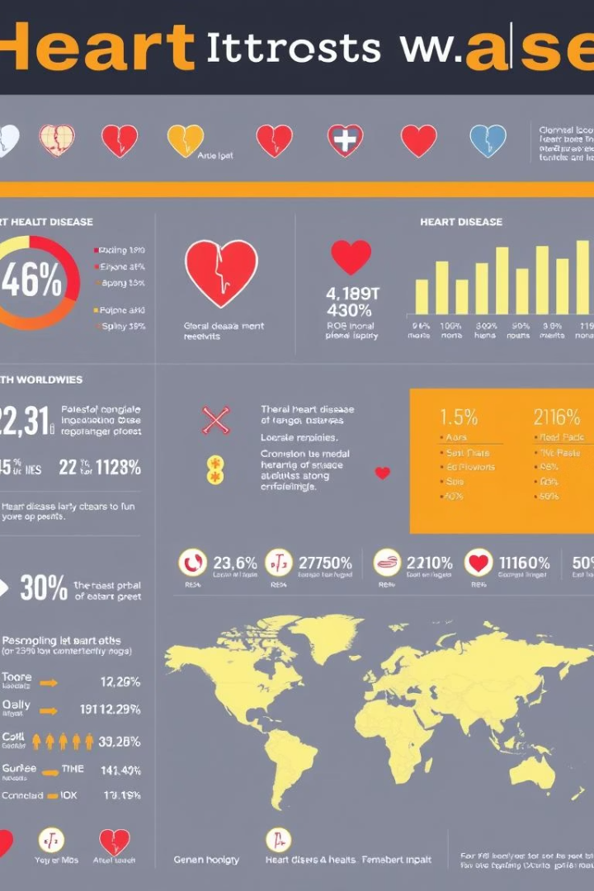
Problem Statement
Global Impact
Heart disease causes 17.9 million deaths annually (WHO, 2021)
Early Detection
Timely diagnosis is essential for effective treatment
Current Challenges
Methods are often invasive or costly
Opportunity
Non-invasive, affordable prediction models needed

Slide 3
Introduction
Heart disease is influenced by risk factors like age and cholesterol.
Machine learning plays a vital role in healthcare innovation.
Data mining helps detect risks for early intervention.
Predictive analytics market predicted to reach $23.2B by 2027.

Slide 4

Dataset Description
Source & Size
303 patient records from UCI Machine Learning Repository
Features
14 attributes including age, sex, chest pain type, blood pressure, cholesterol
Target
Presence or absence of heart disease
Preprocessing
Data cleaned and prepared for modeling

Slide 5




Methodology: Feature Selection
Correlation Analysis
Remove highly correlated features
SelectKBest
Choose top features using Chi-squared test
Dimensionality Reduction
Simplifies data and improves accuracy

Slide 6
Methodology: Model Selection
Logistic Regression
Support Vector Machine
Random Forest
XGBoost
Baseline, simple, interpretable model
Ensemble method, robust to overfitting
Gradient boosting, top-performing model
Effective in complex, high-dimensional spaces

Slide 7

Methodology: Training and Evaluation
Overfitting Prevention
Hyperparameter Tuning
Cross-validation
Regularization and pruning techniques
Split Data
Ensures reliable performance
Optimize using GridSearch
80% training, 20% testing

Slide 8

Results: Performance Metrics
91.2%
0.94
Accuracy
AUC-ROC
XGBoost achieved highest classification rate
Strong discriminatory power
F1
F1 Score
Balanced precision and recall

Slide 9

Discussion and Conclusion
ML Impact
Enables accurate, non-invasive heart disease prediction
Best Model
XGBoost outperforms other algorithms in this task
Future Directions
Add more data and conduct external validations
Clinical Potential
Supports decision-making in healthcare systems

Slide 10

References
World Health Organization (WHO) Heart Disease Statistics
Centers for Disease Control and Prevention (CDC) Data
UCI Machine Learning Repository Heart Disease Dataset
Key Research Papers on ML Heart Disease Prediction

